Slide 1
ASSESSING PEDESTIRANS’ EXPOSURE TO TRAFFIC NOISE WITH SPATIAL ANALYSIS:
THE EFFECTS OF ROUTE CHOICE AND HOME LOCATION
-
Working title
20.3.2019
Research plan
Joose Helle

Slide 2
INTRODUCTION
Active transport modes are considered healthier and more sustainable
Thus, they are being promoted in many cities
Walking is evidently the most popular active transport mode
However, potential health benefits of walking may get compromised due to the negative effects of vehicular traffic
Vehicular traffic causes pollution which reduces walkability
Air pollution, noise and visual pollution
Walkability is a complex concept that aims to consider everything that affects the opportunities for walking
Safety, utility, comfort, ease, accessibility, etc.
INTRODUCTION ▶︎ BACKGROUND ︎▶ AIMS OF THE STUDY ▶ MATERIALS & METHODS ▶ EXPECTED RESULTS ▶ DISCUSSION
Notes:
Add ! Visual pollution

Slide 3
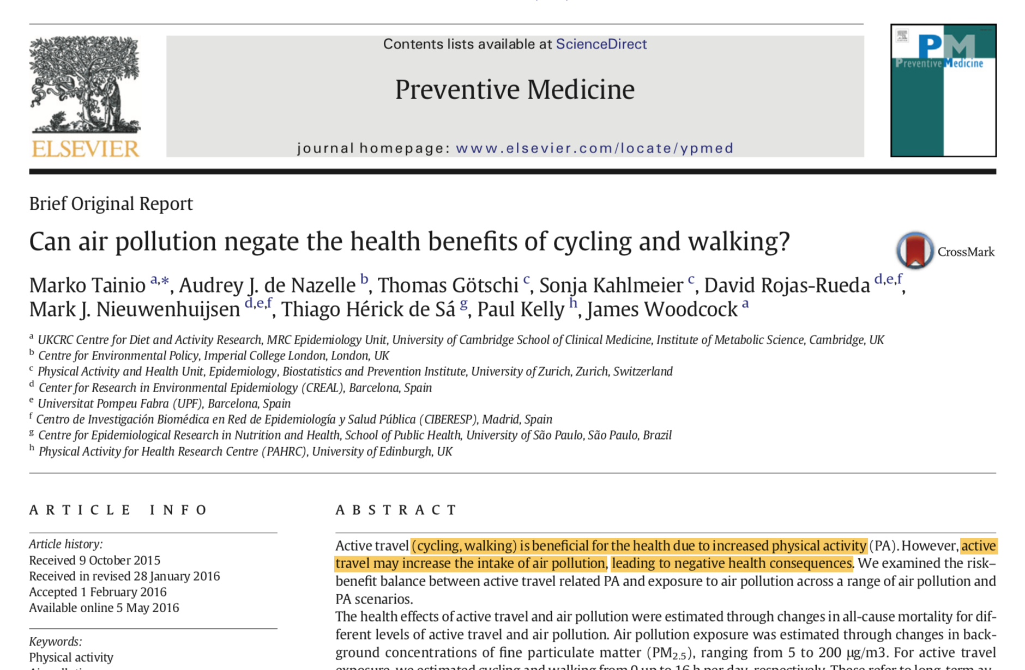
INTRODUCTION ▶︎ BACKGROUND ︎▶ AIMS OF THE STUDY ▶ MATERIALS & METHODS ▶ EXPECTED RESULTS ▶ DISCUSSION

Slide 4
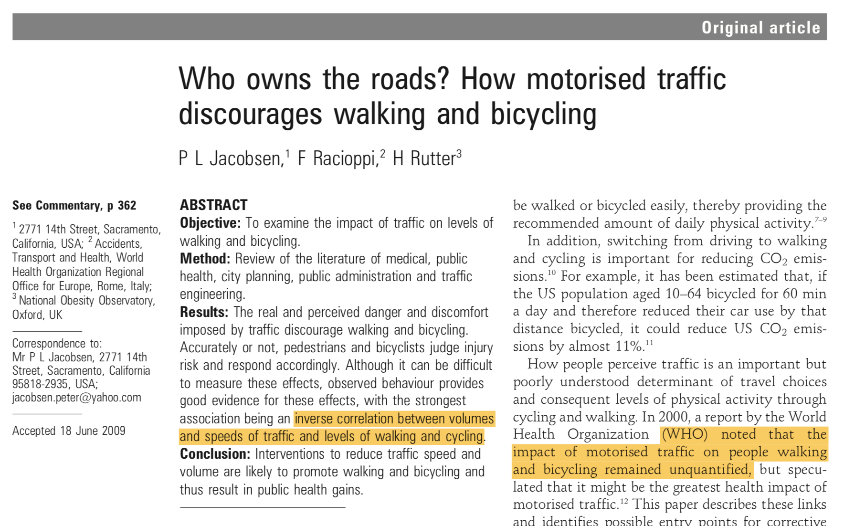
There seem to be an apparent conflict of interests between road users...
INTRODUCTION ▶︎ BACKGROUND ︎▶ AIMS OF THE STUDY ▶ MATERIALS & METHODS ▶ EXPECTED RESULTS ▶ DISCUSSION

Slide 5
BACKGROUND
The concept of how different pollutants are experienced by citizens is called exposure
Many of the previous studies on exposures to traffic noise have focused on counting the residents exposed to certain traffic noise levels based on their home location
Fixed thresholds (dB) have been defined as harmful traffic noise levels
Also some EU and national legislations require these assessments
Conceptually straightforward
Relatively easy to study via spatial analysis: overlay of census data and noise level surfaces
Static approach ignores the mobility of the residents
INTRODUCTION ▶︎ BACKGROUND ︎▶ AIMS OF THE STUDY ▶ MATERIALS & METHODS ▶ EXPECTED RESULTS ▶ DISCUSSION

Slide 6
However, true exposure is dynamic
Daily movements: home location, route selection, etc.
Used transport modes
More realistic approaches to assess citizens’ exposure to air/noise pollution consider mobility
Pedestrians & cyclists are most exposed -> emphasis on active transport
Most citizens are pedestrians every day -> emphasis on walking
Pedestrians’ exposure to pollutants can be quantified as distance or time spent (walking) in areas with different concentrations/levels (of pollutants)
INTRODUCTION ▶︎ BACKGROUND ︎▶ AIMS OF THE STUDY ▶ MATERIALS & METHODS ▶ EXPECTED RESULTS ▶ DISCUSSION

Slide 7
Exposure as durations at different traffic noise levels along a walking route
INTRODUCTION ▶︎ BACKGROUND ︎▶ AIMS OF THE STUDY ▶ MATERIALS & METHODS ▶ EXPECTED RESULTS ▶ DISCUSSION

Slide 8
At least two approaches for assessing these exposures exist:
Direct way: using measurement instruments attached to members of a study group and tracking them spatio-temporally
Indirect way: using spatial analysis to extract modelled concentrations/levels of pollutants to either modelled or tracked paths of people
INTRODUCTION ▶︎ BACKGROUND ︎▶ AIMS OF THE STUDY ▶ MATERIALS & METHODS ▶ EXPECTED RESULTS ▶ DISCUSSION

Slide 9
Health effects of traffic noise
In many studies, health effects of traffic noise have been assessed
The challenge has often been to separate the health effects caused by the noise from the effects of other environmental factors / pollutants
Yet, it is evident that traffic noise affects citizens physical and mental health in many ways
Stress
Problems in blood circulation (increased blood pressure etc.)
Reduced quality of life
INTRODUCTION ▶︎ BACKGROUND ︎▶ AIMS OF THE STUDY ▶ MATERIALS & METHODS ▶ EXPECTED RESULTS ▶ DISCUSSION

Slide 10

INTRODUCTION ▶︎ BACKGROUND ︎▶ AIMS OF THE STUDY ▶ MATERIALS & METHODS ▶ EXPECTED RESULTS ▶ DISCUSSION

Slide 11
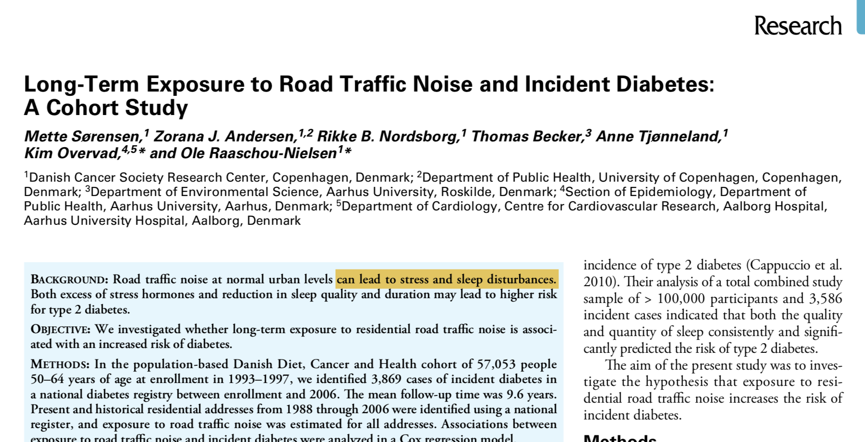
INTRODUCTION ▶︎ BACKGROUND ︎▶ AIMS OF THE STUDY ▶ MATERIALS & METHODS ▶ EXPECTED RESULTS ▶ DISCUSSION

Slide 12
Traffic noise is modelled in many cities with high spatial precision
EU legislation requires the assessments
Modelled traffic noise data facilitates exposure analysis
Traffic count data & measured noise levels
Geometries and materials of structures of the environment
Mathematical equations to assess absorption and transmission of sound in 3D landscape (featuring varying textures, surfaces & geometries)
How to minimize the exposure to traffic noise?
Pedestrian-friendly alternatives are needed to simple shortest paths
Green/healthy/safe/clean/quiet path routing, as a concepts, aim to take walkability into account in route optimization
Safety, air quality, noise levels
Presence of vegetation, green views
Other environmental variables that affect walkability
INTRODUCTION ▶︎ BACKGROUND ︎▶ AIMS OF THE STUDY ▶ MATERIALS & METHODS ▶ EXPECTED RESULTS ▶ DISCUSSION

Slide 13
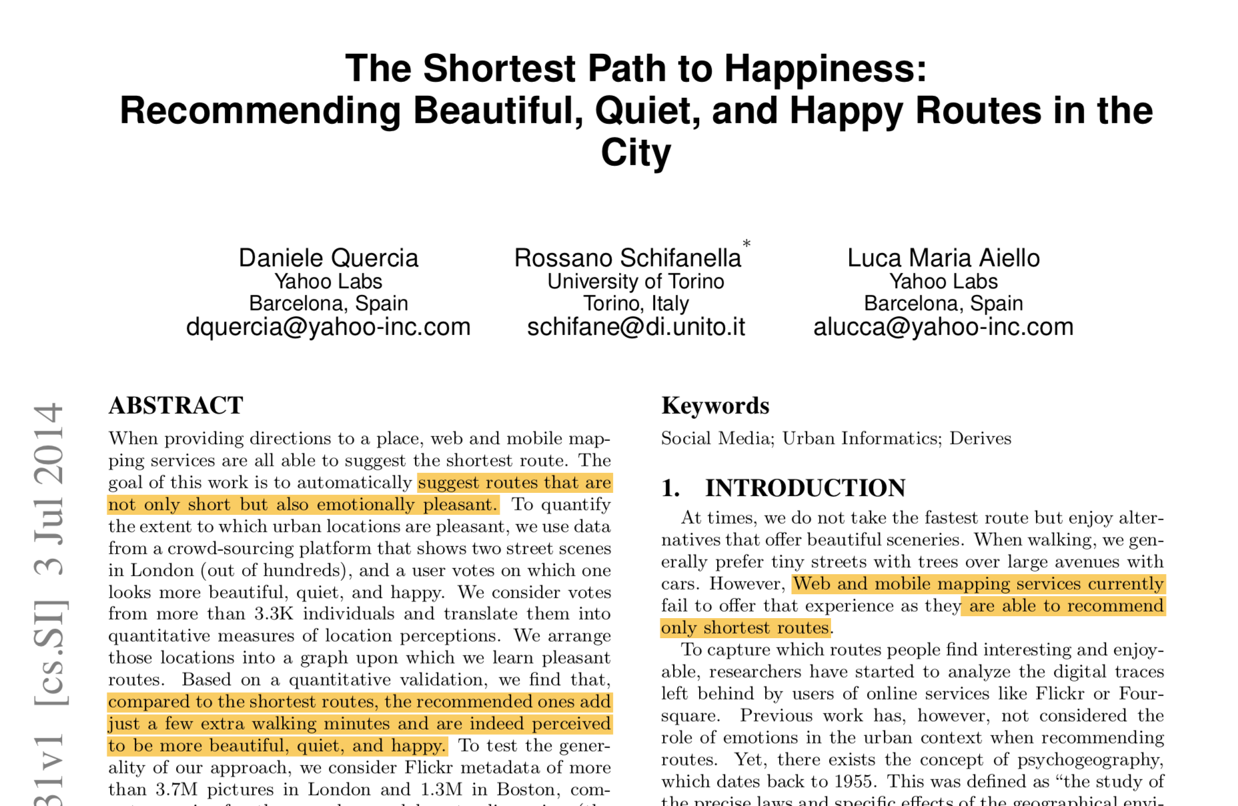
INTRODUCTION ▶︎ BACKGROUND ︎▶ AIMS OF THE STUDY ▶ MATERIALS & METHODS ▶ EXPECTED RESULTS ▶ DISCUSSION

Slide 14
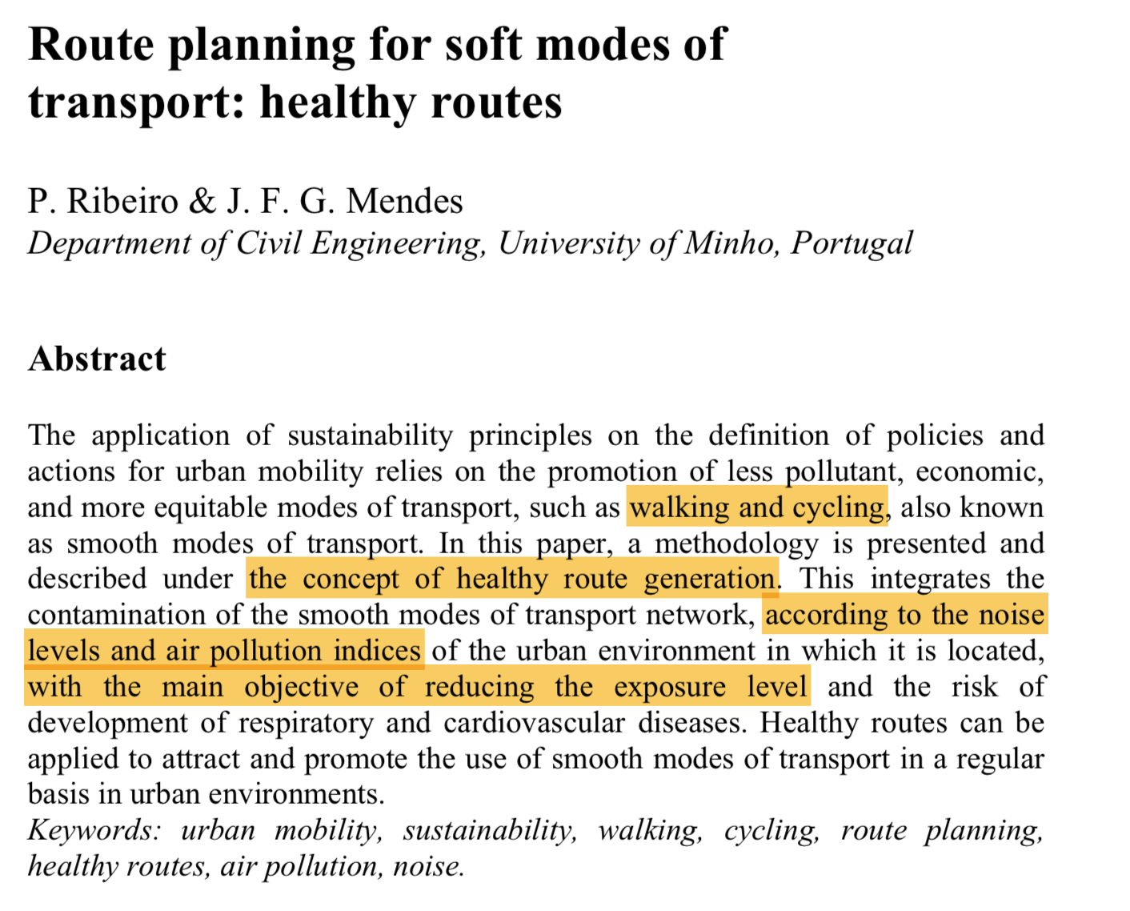
INTRODUCTION ▶︎ BACKGROUND ︎▶ AIMS OF THE STUDY ▶ MATERIALS & METHODS ▶ EXPECTED RESULTS ▶ DISCUSSION

Slide 15
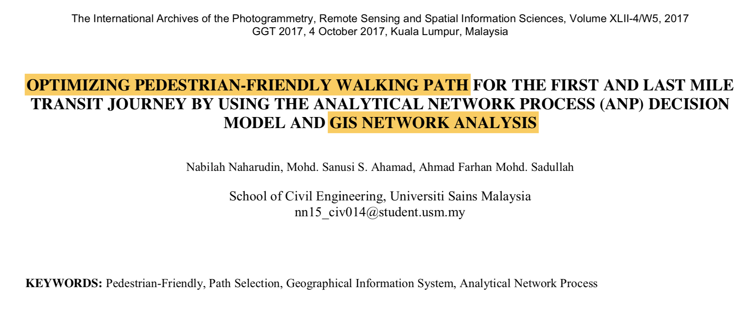
INTRODUCTION ▶︎ BACKGROUND ︎▶ AIMS OF THE STUDY ▶ MATERIALS & METHODS ▶ EXPECTED RESULTS ▶ DISCUSSION

Slide 16
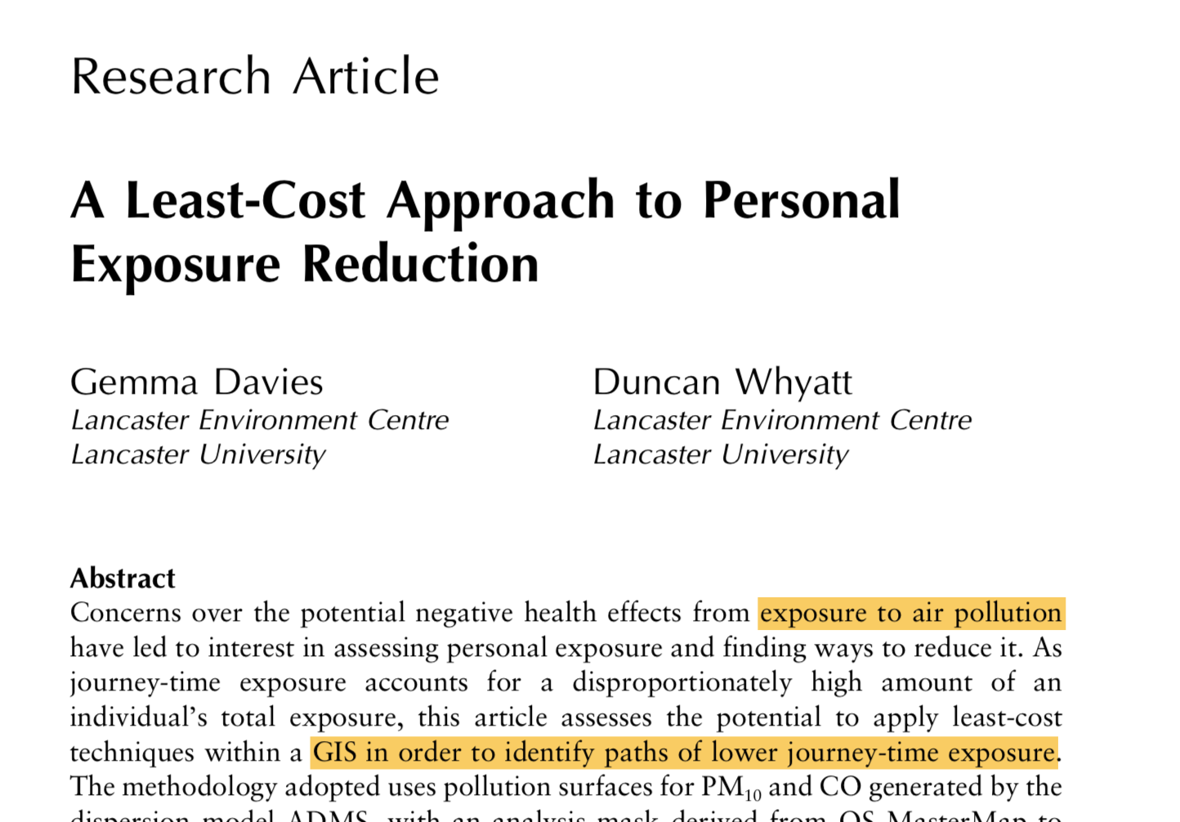
INTRODUCTION ▶︎ BACKGROUND ︎▶ AIMS OF THE STUDY ▶ MATERIALS & METHODS ▶ EXPECTED RESULTS ▶ DISCUSSION

Slide 17
Route optimization algorithms can be used to find shortest paths in a network (graph)
Utilizes graph theory: navigable networks of nodes and segments (connections) (e.g. network of streets & intersections)
e.g. Dijkstra’s algorithm finds the shortest path between nodes in a graph
INTRODUCTION ▶︎ BACKGROUND ︎▶ AIMS OF THE STUDY ▶ MATERIALS & METHODS ▶ EXPECTED RESULTS ▶ DISCUSSION

Slide 18
Usually lengths of the segments are used as the costs
Real-world applications require more complex graphs
Directed graphs
Intersection costs
Speed limits
Custom costs
Walkability
INTRODUCTION ▶︎ BACKGROUND ︎▶ AIMS OF THE STUDY ▶ MATERIALS & METHODS ▶ EXPECTED RESULTS ▶ DISCUSSION

Slide 19
Exposures to pollutants at different parts of the network can be used as additional weights in the shortest path analysis
Noise levels (or air pollutions) are assigned to street segments of the network (spatial join) -> network of “contaminated distances”
Environmental impedance function is needed to convert the contaminated distances into costs usable by the route optimization algorithms
-> More pedestrian-friendly routes
Challenge is often the validation and definition of thresholds for different pollutants
INTRODUCTION ▶︎ BACKGROUND ︎▶ AIMS OF THE STUDY ▶ MATERIALS & METHODS ▶ EXPECTED RESULTS ▶ DISCUSSION

Slide 20
AIMS OF THE STUDY
Develop a “quiet path” routing method that optimizes more pedestrian-friendly walking routes by minimizing exposure to traffic noise
Explore spatial patterns in pedestrians’ exposure to traffic noise on the walks to local public transport hubs (stations) and to local grocery stores:
Which residential areas accumulate the highest pedestrians’ exposures to traffic noise?
How the opportunities to choose healthier (less noisy) walking routes are distributed spatially?
INTRODUCTION ▶︎ BACKGROUND ︎▶ AIMS OF THE STUDY ▶ MATERIALS & METHODS ▶ EXPECTED RESULTS ▶ DISCUSSION

Slide 21
AIMS OF THE STUDY
Publish the quiet path routing method as a stand-alone proof-of-concept (POC) quiet path planner app with a web user interface
User can plan more pedestrian-friendly walking routes with the service
Web map application: client-side interactive web map + server-side routing application
Explore opportunities to implement the quiet path routing in HRT’s route planner
It’s open source and uses OpenTripPlanner (OTP)
INTRODUCTION ▶︎ BACKGROUND ︎▶ AIMS OF THE STUDY ▶ MATERIALS & METHODS ▶ EXPECTED RESULTS ▶ DISCUSSION

Slide 22
The best possible outcome of the study would be to facilitate both:
City planners to discover areal needs for improving walking conditions
Citizens to choose healthier (i.e. quieter) walking routes during their daily mobility
INTRODUCTION ▶︎ BACKGROUND ︎▶ AIMS OF THE STUDY ▶ MATERIALS & METHODS ▶ EXPECTED RESULTS ▶ DISCUSSION

Slide 23
MATERIALS
Modelled Traffic noise zones in Helsinki 2017
Urban Environment Division of city of Helsinki
WFS Service: spatial data in surface/polygon format
Noise range information as attributes (45-50, 50-55 dB etc.)
OpenStreetMap (OSM)
Data will be acquired programmatically using Overpass API
Tag ‘highway’ is used to get all road segments
Walkable street segments are filtered from the data (based on tag-key -value pairs) and used in the network construction
INTRODUCTION ▶︎ BACKGROUND ︎▶ AIMS OF THE STUDY ▶ MATERIALS & METHODS ▶ EXPECTED RESULTS ▶ DISCUSSION

Slide 24
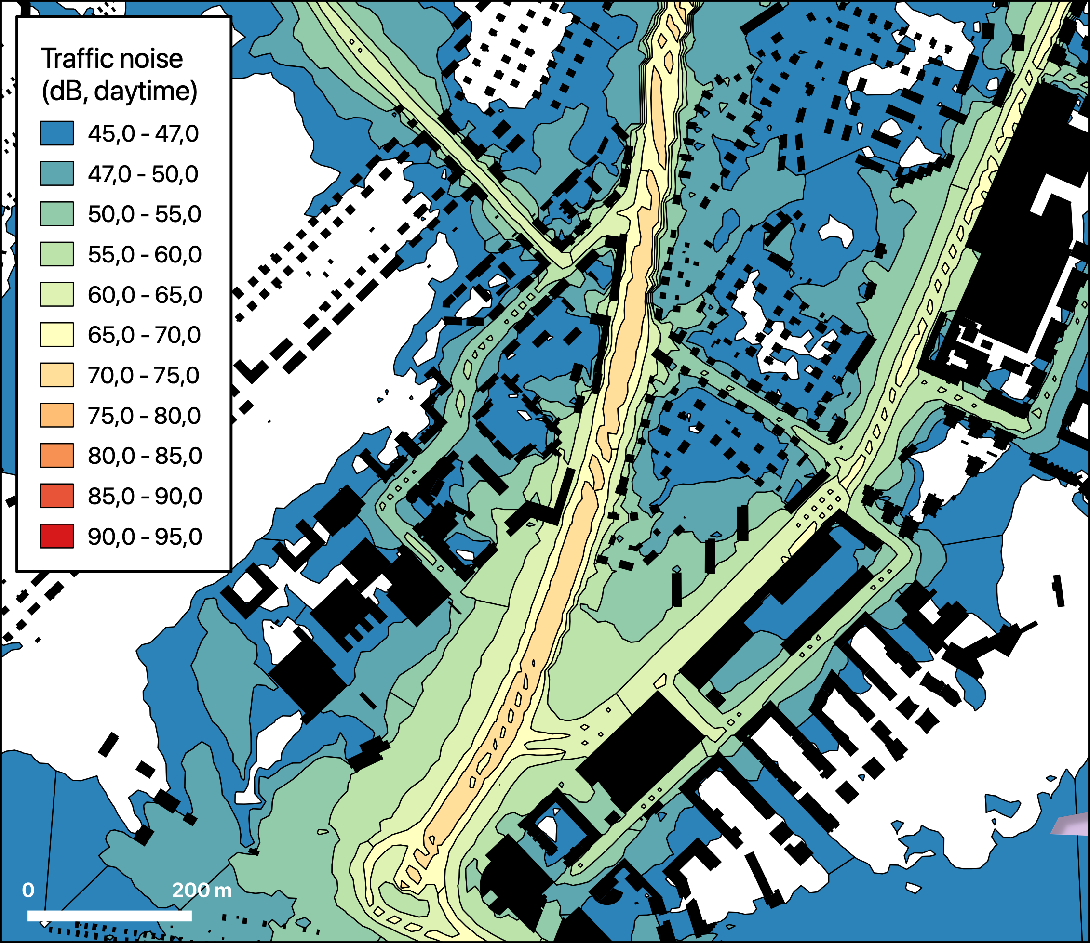

Slide 25
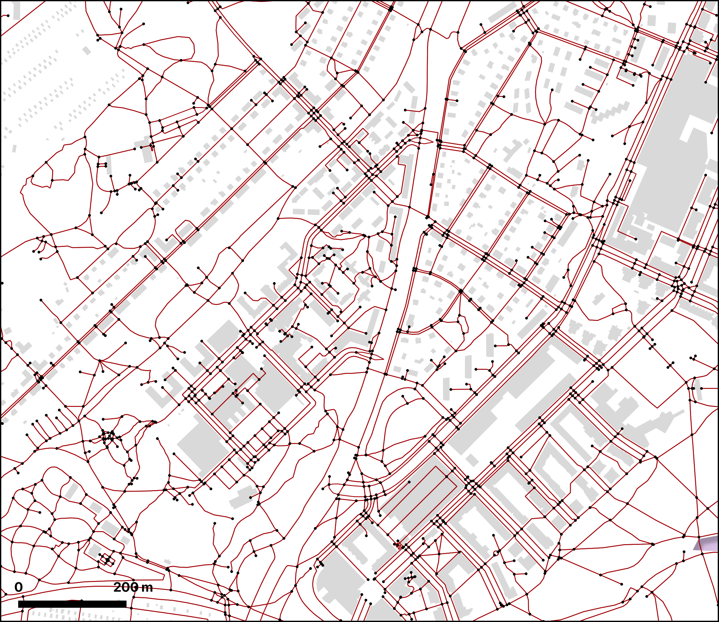

Slide 26
Digitransit Routing API
Used to query the routes from residential areas to workplaces
Walking legs of the planned itineraries (routes) are used in the exposure analysis
YKR Population grid
250m x 250m polygon grid layer
Centers of the grid cells are used as origins in the routing analysis
Cumulative exposures are aggregated by the origin grid cells
YKR Workplace grid
Centers of the grid cells are used as destinations in the routing analysis
Grocery stores
Walking routes are also calculated from each origin cell to the closest grocery store for exposure analysis
INTRODUCTION ▶︎ BACKGROUND ︎▶ AIMS OF THE STUDY ▶ MATERIALS & METHODS ▶ EXPECTED RESULTS ▶ DISCUSSION

Slide 27
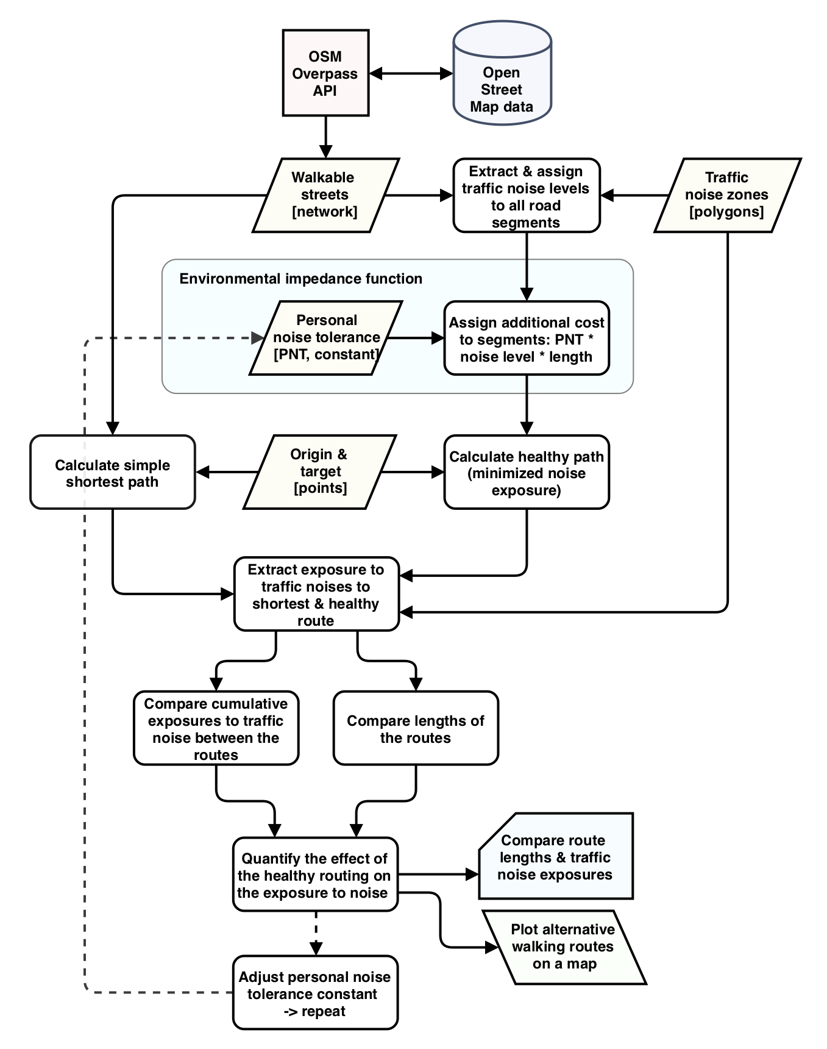
METHODS
Acquiring and manipulating walkable street network
Query walkable OSM edges from Overpass API
Use OSMnx* to convert OSM data into (NetworkX*) graph
Extract & assign traffic noise levels to all segments of the network as attributes
* Python library
INTRODUCTION ▶︎ BACKGROUND ︎▶ AIMS OF THE STUDY ▶ MATERIALS & METHODS ▶ EXPECTED RESULTS ▶ DISCUSSION

Slide 28
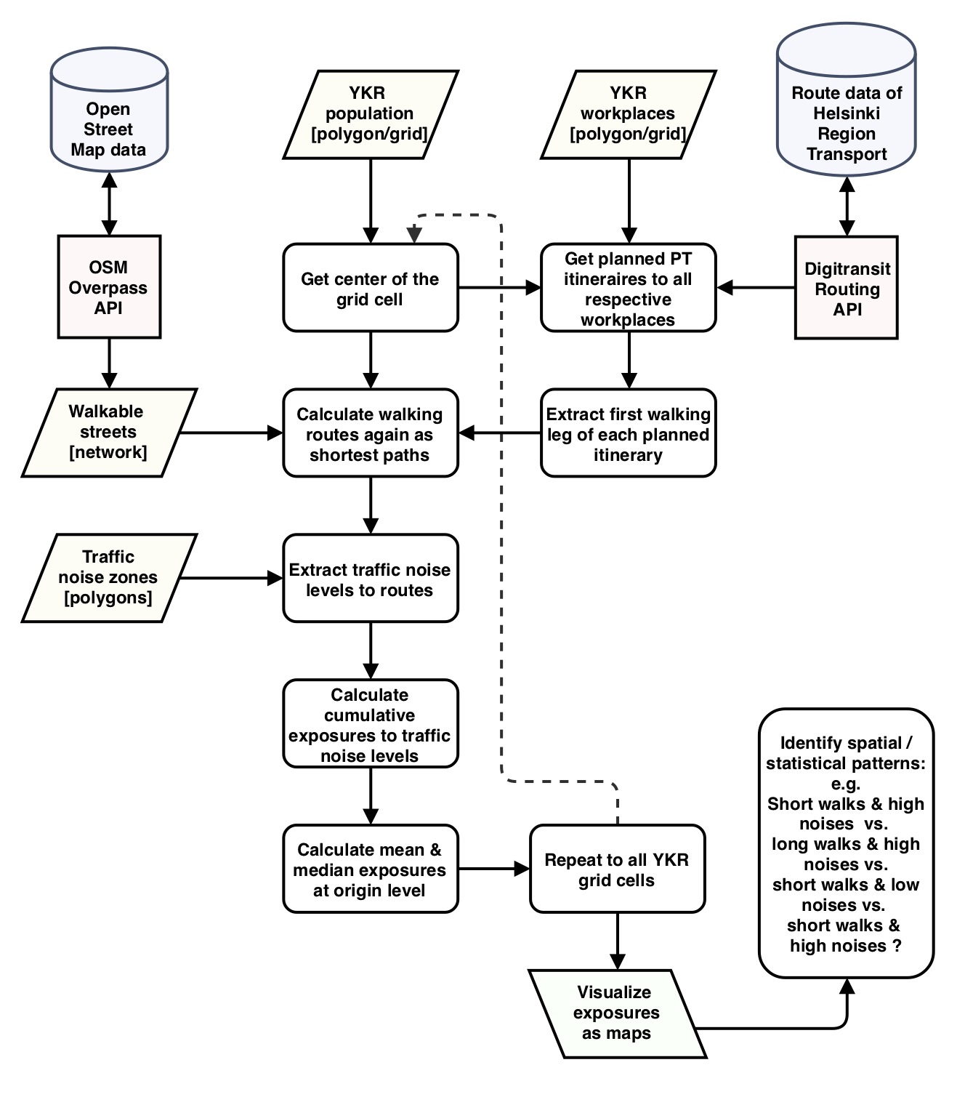
Itinerary planning from all origins to their respective workplaces
Query planned itineraries from Digitransit Routing API
Extract first walking leg of each planned itinerary (origin - PT station/destination)
Focus on areal/neighborhood level pedestrian activity
Avoid overly complex analysis
Majority of the walking gets still assessed
Aggregate origin-PT station pairs
INTRODUCTION ▶︎ BACKGROUND ︎▶ AIMS OF THE STUDY ▶ MATERIALS & METHODS ▶ EXPECTED RESULTS ▶ DISCUSSION

Slide 29
Shortest paths and exposures to traffic noises
Calculate shortest paths for each origin-PT station pair
Calculate shortest paths for each origin– closest grocery store pair
Extract & join exposures to traffic noise to each walk
Aggregate exposures to traffic noise at origin level (mean, median etc.)
Visualize the results (maps & figures)
INTRODUCTION ▶︎ BACKGROUND ︎▶ AIMS OF THE STUDY ▶ MATERIALS & METHODS ▶ EXPECTED RESULTS ▶ DISCUSSION

Slide 30
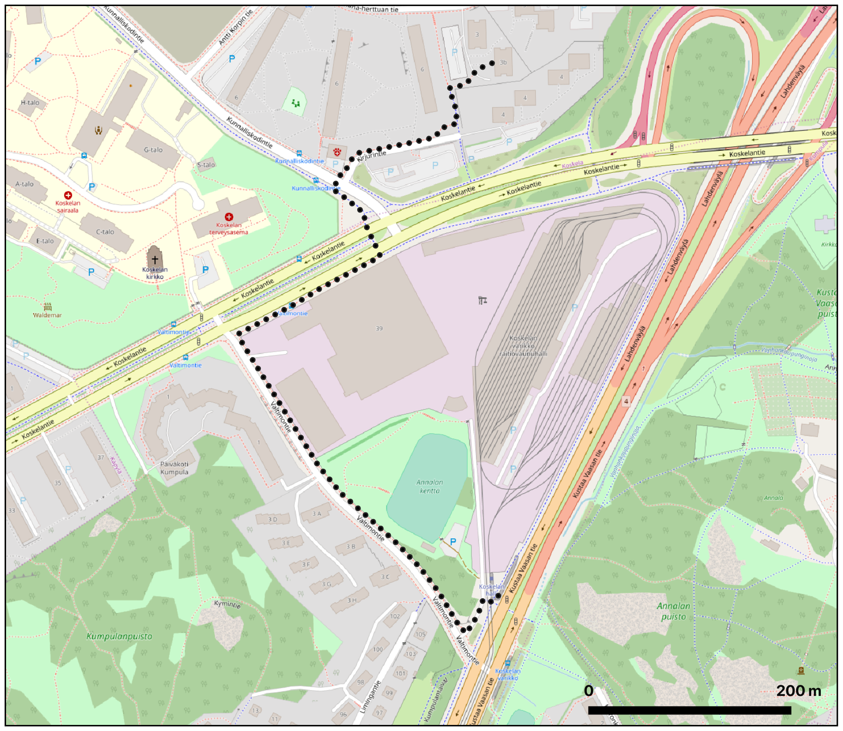

Slide 31
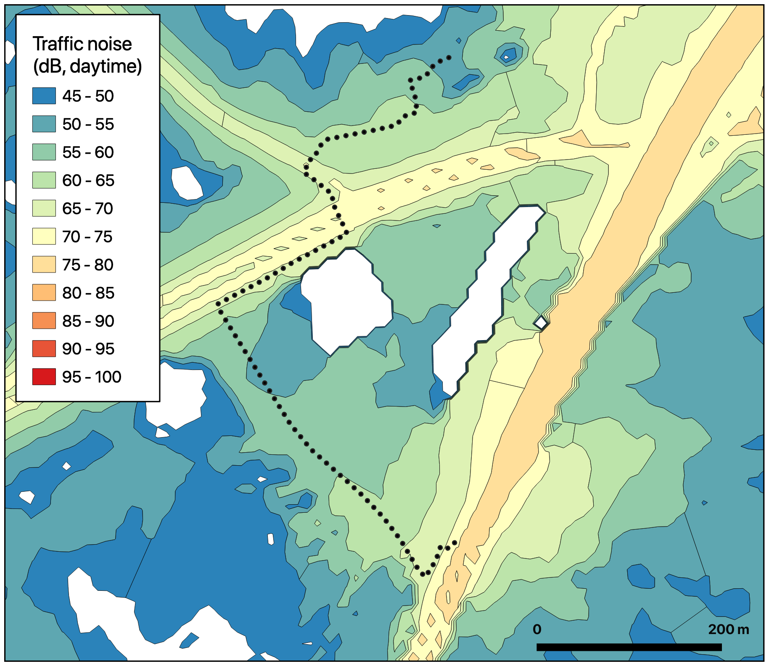

Slide 32
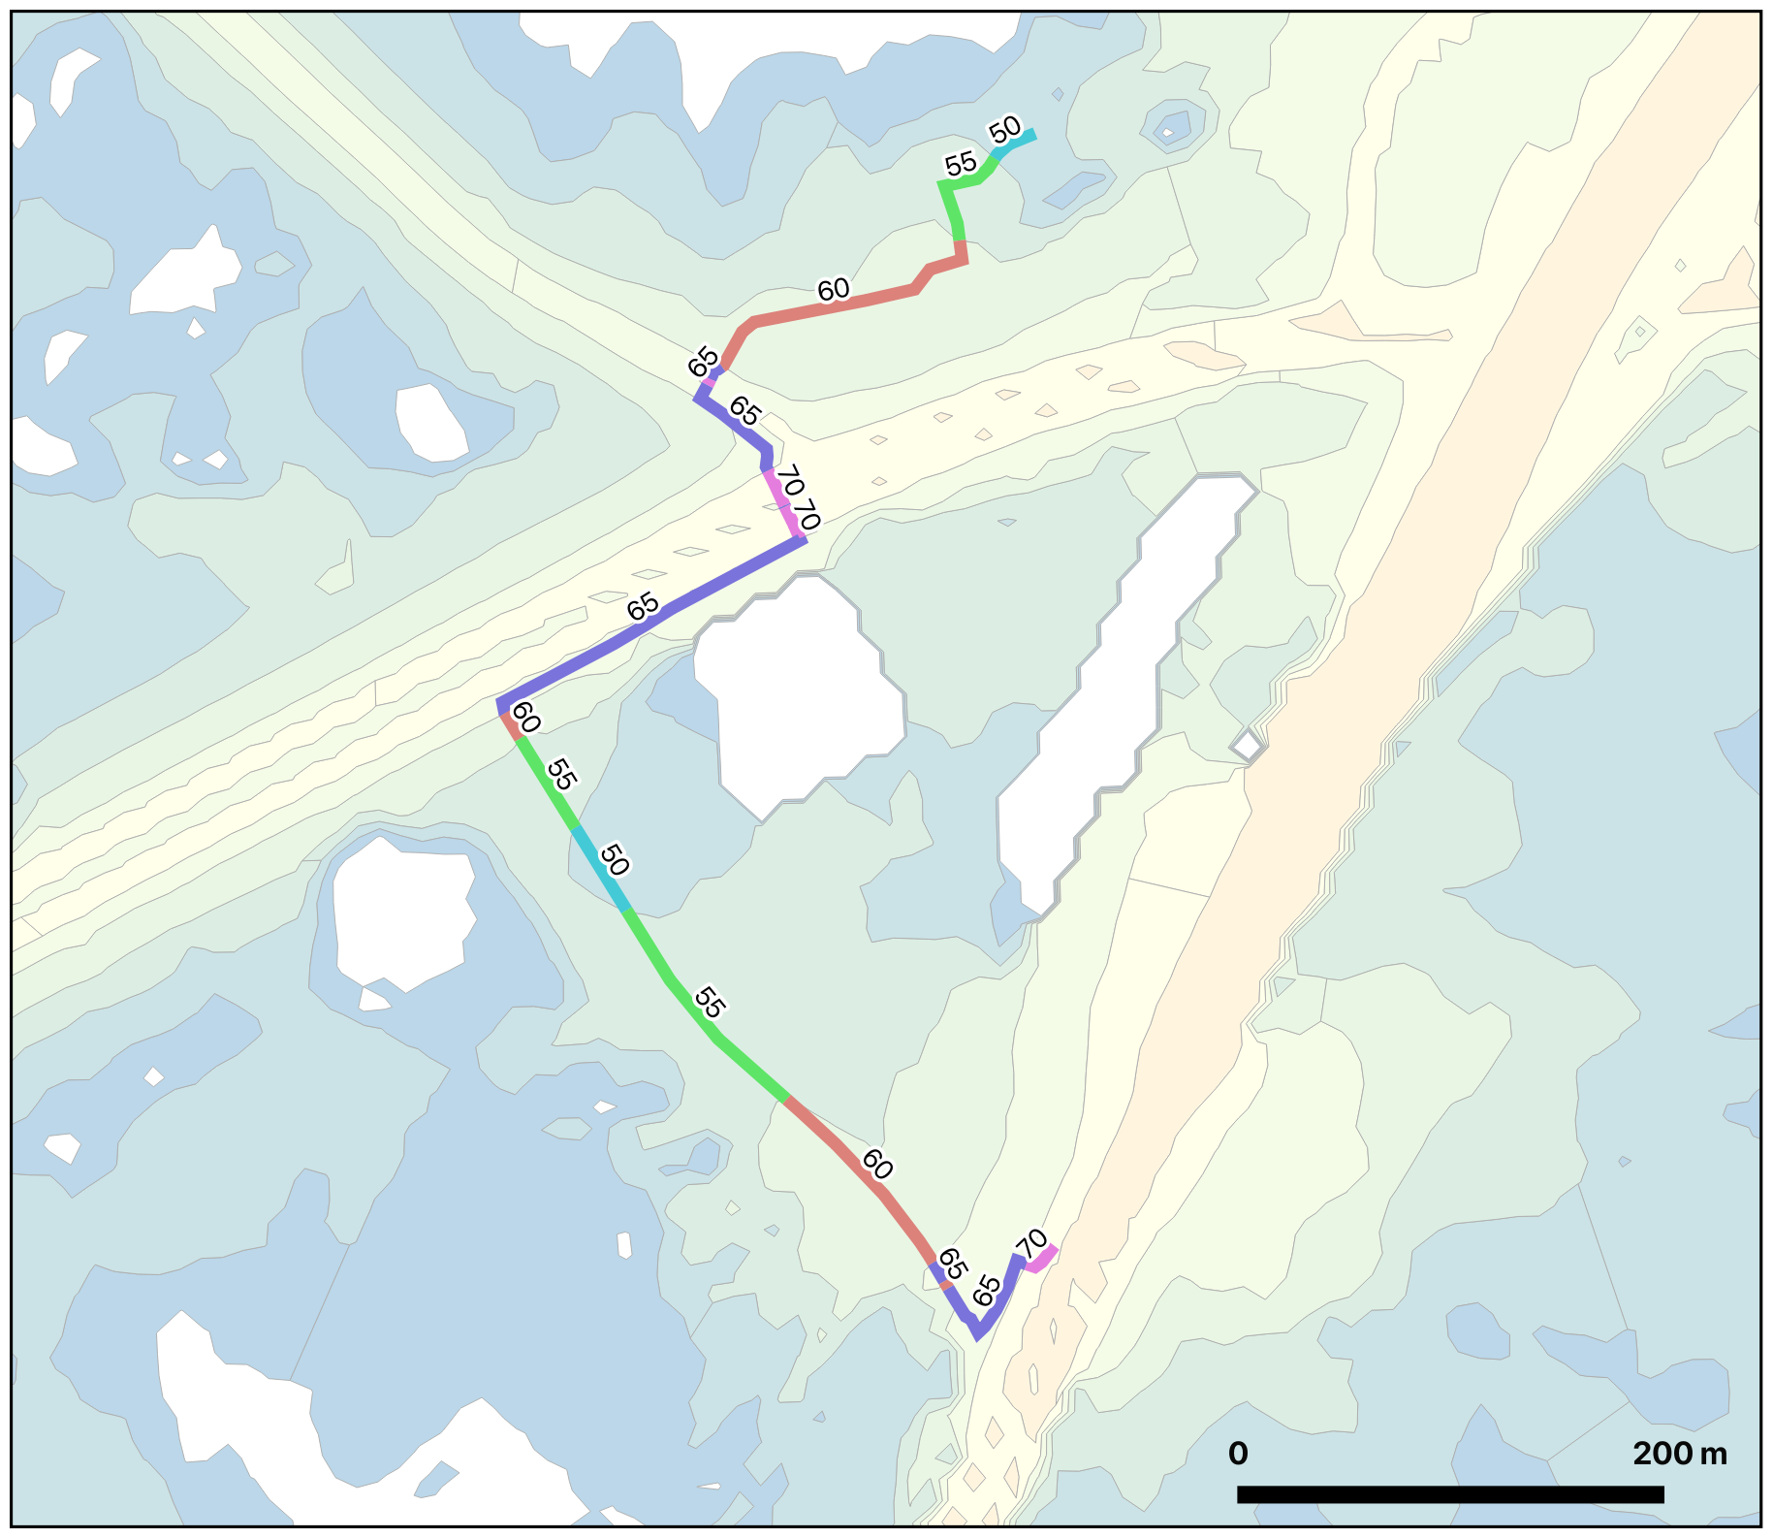

Slide 33
Exposure to traffic noise as distances and durations at different traffic noise levels along the walking route
INTRODUCTION ▶︎ BACKGROUND ︎▶ AIMS OF THE STUDY ▶ MATERIALS & METHODS ▶ EXPECTED RESULTS ▶ DISCUSSION

Slide 34
Calculating “quiet paths” by minimizing noise exposure
Assign additional cost to network segments with environmental impedance function: Personal noise tolerance (PNT) * traffic noise levels * length
Calculate shortest paths with respect to additional noise impedances
Compare paths to shortest path (distance & noise exposure)
Adjust PNT and repeat...
Visualize the results (maps & figures)
INTRODUCTION ▶︎ BACKGROUND ︎▶ AIMS OF THE STUDY ▶ MATERIALS & METHODS ▶ EXPECTED RESULTS ▶ DISCUSSION

Slide 35


Slide 36
Exposure to traffic noise along walking route 1 (920 m / 11.5 min)
INTRODUCTION ▶︎ BACKGROUND ︎▶ AIMS OF THE STUDY ▶ MATERIALS & METHODS ▶ EXPECTED RESULTS ▶ DISCUSSION

Slide 37
Exposure to traffic noise along walking route 2 (854 m / 10.7 min)
INTRODUCTION ▶︎ BACKGROUND ︎▶ AIMS OF THE STUDY ▶ MATERIALS & METHODS ▶ EXPECTED RESULTS ▶ DISCUSSION

Slide 38
TECHNICAL CONSIDERATIONS
Only open source tools & libraries will be used
Python development environment managed with Conda
Geopandas, Shapely, OSMnx, NetworkX for spatial analysis and network construction
igraph Python library would be a lot faster, but not as convenient as OSMnx + NetworkX
QGIS for the visualizations
Computing power & memory from CSC’s Taito supercluster
Parallel processing with Python
At least for network construction, noise data extractions for segments and route optimizations (shortest paths)
INTRODUCTION ▶︎ BACKGROUND ︎▶ AIMS OF THE STUDY ▶ MATERIALS & METHODS ▶ EXPECTED RESULTS ▶ DISCUSSION

Slide 39
Static files for storing data and results
GeoPackages might outperform Shapefiles when handling large files with Geopandas and QGIS
Probably no need to use databases for performance or due to very large datasets
Reproducibility and quality assurance
All codes shared in GitHub (already now: github.com/hellej/gradu-pocs)
Simple “one line” setup for identical Python environment as used in the study (with Conda)
Functions should be modularized to be useful also in assessing exposures to other pollutants
Highly modularized and well documented codebase (not yet)
INTRODUCTION ▶︎ BACKGROUND ︎▶ AIMS OF THE STUDY ▶ MATERIALS & METHODS ▶ EXPECTED RESULTS ▶ DISCUSSION

Slide 40
The “quiet path” routing as a proof of concept (POC) web app
Route optimization service as a server-side application featuring REST API built with Python + Flask/Django (?)
User interface as a front-end web map application built with ReactJS & Mapbox GL (?)
For each routing query, several alternative routes are shown (on the map)
Minimum viable product
INTRODUCTION ▶︎ BACKGROUND ︎▶ AIMS OF THE STUDY ▶ MATERIALS & METHODS ▶ EXPECTED RESULTS ▶ DISCUSSION

Slide 41
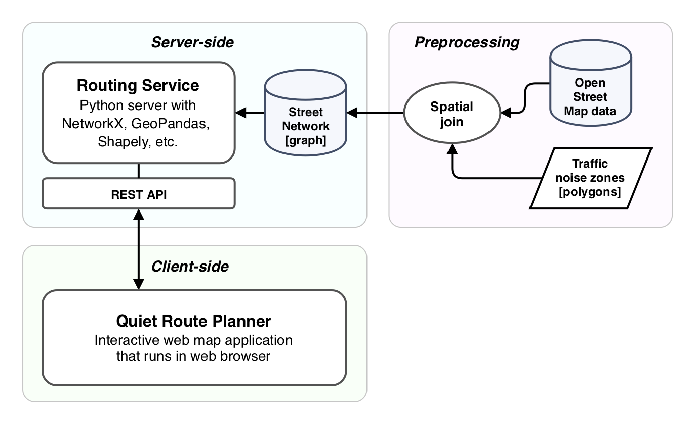
Architecture of the quiet path routing web app:
INTRODUCTION ▶︎ BACKGROUND ︎▶ AIMS OF THE STUDY ▶ MATERIALS & METHODS ▶ EXPECTED RESULTS ▶ DISCUSSION

Slide 42
EXPECTED RESULTS
Higher exposures to traffic noise in some areas
Massive road infrastructure, high (vehicular) traffic flows
Long distances from residential areas to PT stations / grocery stores
Exposed walkways near big highways
Low walkability?
Lower exposures to traffic noise in other areas
Good walkable street network: sheltered and functional walkways
Short distances to PT hubs
Low traffic flows
Residential streets as opposed to big highways
Better walkability?
INTRODUCTION ▶︎ BACKGROUND ︎▶ AIMS OF THE STUDY ▶ MATERIALS & METHODS ▶ EXPECTED RESULTS ▶ DISCUSSION

Slide 43
Opportunities for choosing healthier (less noisy) walking routes are distributed unequally:
More / better opportunities are found in areas where
Noise exposures along the shortest paths are high (also the potential to reduce them is higher)
Sheltered walkways exist and are well connected to the rest of the street network
The walkable street network is dense and hence total number of route options is greater
Less opportunities are found for areas where:
Noise exposures along the shortest paths are already low
No sheltered walkways exist or they are not well connected to the rest of the street network
Sparser network doesn’t provide many route options in the first place
INTRODUCTION ▶︎ BACKGROUND ︎▶ AIMS OF THE STUDY ▶ MATERIALS & METHODS ▶ EXPECTED RESULTS ▶ DISCUSSION

Slide 44
DISCUSSION
More realistic approach to assess citizens’ exposure to air/noise pollution is to also consider their mobility
Spatial analysis can provide estimates of pedestrians’ exposures to traffic noise with limited accuracy
Real “taken” paths are likely to differ from the modelled (shortest) ones
Real traffic noise levels vary in time
”Quiet path” routing is sensitive to the definition of the environmental impedance function
Weighting of varying exposures to different traffic noise levels is subjective and hence tricky
Hence, the sensitivity of the quiet route optimization needs to be evaluated by systematically altering the environmental impedance function
INTRODUCTION ▶︎ BACKGROUND ︎▶ AIMS OF THE STUDY ▶ MATERIALS & METHODS ▶ EXPECTED RESULTS ▶ DISCUSSION

Slide 45
Both exposure to traffic noise and the presence of alternative (better) walking routes need to be known in order to support spatial planning
Exposure to noise along only the shortest path is not enough
Exposure to noise along the alternative (short) paths is essential
If exposures to noise are high both along the shortest and the alternative paths (if any), actions should be crafted to improve opportunities for walking in the area
Quiet path routing method needs to be published in order to improve citizens quality of life
Nothing but a static python script collecting dust in a GitHub repository doesn’t help anyone to choose better walking routes
Hopefully the implementation of the interactive web map route planner application is feasible enough
...Or that HRT implements something similar in their route planner
INTRODUCTION ▶︎ BACKGROUND ︎▶ AIMS OF THE STUDY ▶ MATERIALS & METHODS ▶ EXPECTED RESULTS ▶ DISCUSSION

Slide 46
SCHEDULE
Gathering literature
January - March
Analysis
March – April
Visualizations and writing
April – May
Done?
June
INTRODUCTION ▶︎ BACKGROUND ︎▶ AIMS OF THE STUDY ▶ MATERIALS & METHODS ▶ EXPECTED RESULTS ▶ DISCUSSION

